Slide 1
Data & Preprocessing
Sigit Priyanta

Slide 2




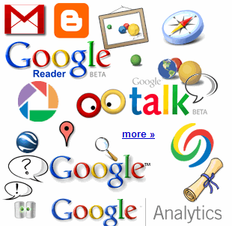

Where Is This “Big Data” Coming From ?
30 billion RFID tags today (1.3B in 2005)
4.6 billion camera phones world wide
12+ TBs of tweet data every day
100s of millions of GPS enabled devices sold annually
? TBs of data every day
2+ billion people on the Web by end 2011
25+ TBs of log data every day
76 million smart meters in 2009… 200M by 2014
Notes:
Obviously, there are many other forms and sources of data. Let’s start with the hottest topic associated with Big Data today: social networks. Twitter generates about 12 terabytes a day of tweet data – which is every single day. Now, keep in mind, these numbers are hard to count on, so the point is that they’re big, right? So don’t fixate on the actual number because they change all the time and realize that even if these numbers are out of date in 2 years, it’s at a point where it’s too staggering to handle exclusively using traditional approaches.
+CLICK+
Facebook over a year ago was generating 25 terabytes of log data every day (Facebook log data reference: http://www.datacenterknowledge.com/archives/2009/04/17/a-look-inside-facebooks-data-center/ ) and probably about 7 to 8 terabytes of data that goes up on the Internet.
+CLICK+
Google, who knows? Look at Google Plus, YouTube, Google Maps, and all that kind of stuff. So that’s the left hand of this chart – the social network layer.
+CLICK+
Now let’s get back to instrumentation: there are massive amounts of proliferated technologies that allow us to be more interconnected than in the history of the world – and it just isn’t P2P (people to people) interconnections, it’s M2M (machine to machine) as well. Again, with these numbers, who cares what the current number is, I try to keep them updated, but it’s the point that even if they are out of date, it’s almost unimaginable how large these numbers are. Over 4.6 billion camera phones that leverage built-in GPS to tag the location or your photos, purpose built GPS devices, smart metres. If you recall the bridge that collapsed in Minneapolis a number of years ago in the USA, it was rebuilt with smart sensors inside it that measure the contraction and flex of the concrete based on weather conditions, ice build up, and so much more.
So I didn’t realise how true it was when Sam P launched Smart Planet: I thought it was a marketing play. But truly the world is more instrumented, interconnected, and intelligent than it’s ever been and this capability allows us to address new problems and gain new insight never before thought possible and that’s what the Big Data opportunity is all about!
2

Slide 3
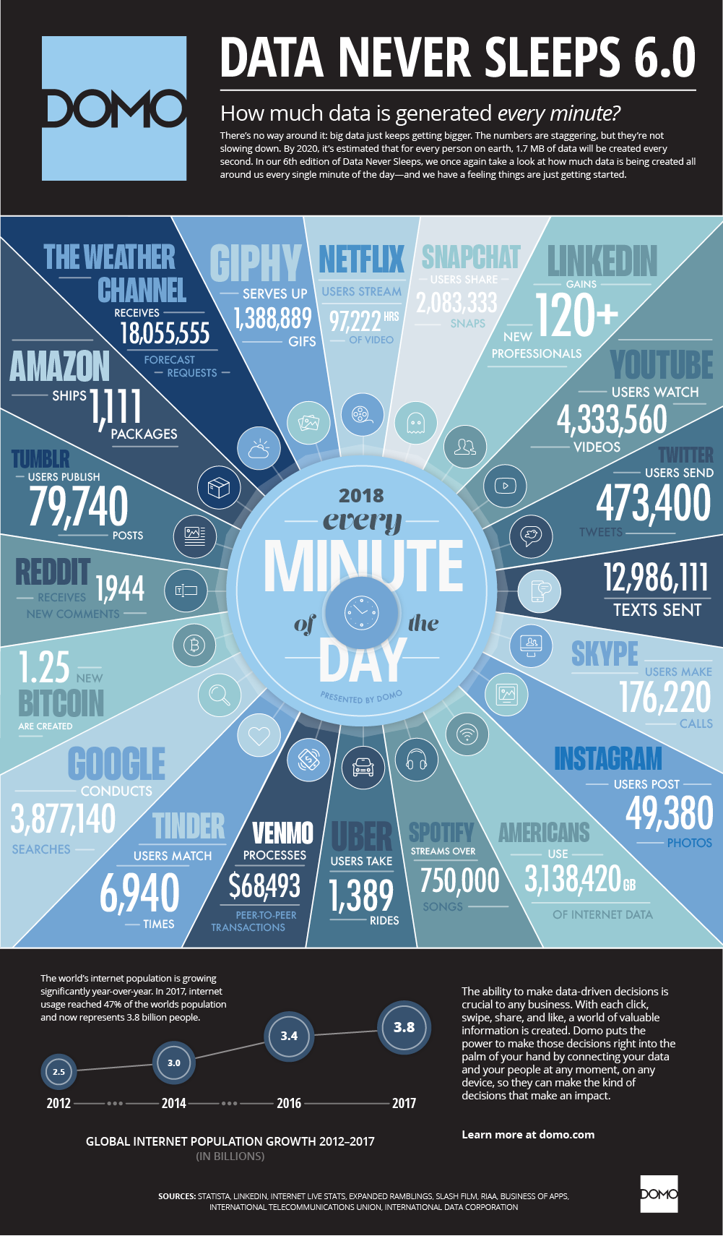

















Social Media
Banking
Finance
Gaming
Our
Known
History
Customer
Entertain
Purchase

Slide 4










The 5 Key Big Data Use Cases
Big Data Exploration
Find, visualize, understand all big data to improve decision making
Enhanced 360º View of the Customer
Extend existing customer views (MDM, CRM, etc) by incorporating additional internal and external information sources
Security/Intelligence Extension
Lower risk, detect fraud and monitor cyber security in real-time
Operations Analysis
Analyze a variety of machine data for improved business results
Data Warehouse Augmentation
Integrate big data and data warehouse capabilities to increase operational efficiency
Notes:
Our product management, engineering, marketing, CTPs, etc, etc teams have all been working together to help to better understand the big data market. We’ve done surveys, met with analysts and studied their findings, we’ve met in person with customers and prospects (over 300 meetings) and are confident that we found market “sweet spots” for big data. These 5 use cases are our sweet spots. These will resonate with the majority of prospects that you meet with. In the coming slides we’ll cover each of these in detail, we’ll walk through the need, the value and a customer example.

Slide 5



Big Data Exploration: Needs
Find, visualize, understand all big data to improve decision making
Struggling to manage and extract value from the growing 3 V’s of data in the enterprise; Need to unify information across federated sources
Inability to relate “raw” data collected from system logs, sensors, clickstreams, etc., with customer and line-of-business data managed in enterprise systems
Risk of exposing unsecure personally identifiable information (PII) and/or privileged data due to lack of information awareness
Notes:
5

Slide 6

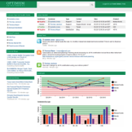




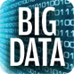


Big Data Exploration: Value & Diagram
Relational
Data
Find, Visualize & Understand all big data to improve business knowledge
Greater efficiencies in business processes
New insights from combining and analyzing data types in new ways
Develop new business models with resulting increased market presence and revenue
File
Systems
Content
Management
Email
CRM
Application/
Users
Data Explorer
Supply
Chain
ERP
RSS Feeds
Cloud
Custom
Sources
Notes:
Enterprise-wide, InfoSphere Data Explorer addresses the ongoing challenge of “information silos,” a challenge that isn’t going away any time soon. Each of the systems in your enterprise was designed to serve a critical function, whether it’s managing customer data, managing your supply chain, securing sensitive content or any of a myriad of different functions. Systems such as CRM, ECM, supply chain management, e-mail and others are necessary to perform these specific functions. Each of these systems is a silo with its own login, user interface and way of delivering information. The problem is that almost no one in your organization can rely on only one of these silos for the information they need to do their job. [click] Velocity delivers business value by enabling everyone—from management through knowledge workers to front-line employees—to access all of the information they need in a single view, regardless of format or where it is managed. Rather than wasting time accessing each silo separately, Velocity enables them to navigate seamlessly across all available sources, and provides the added advantage of cross-repository visibility. Information is secured so that users only see the content that they are permitted to view when logged directly into the target application. [click] In addition, Velocity gives users the ability to comment, tag and rate content, as well as create shared folders for content they would like to share with other users. [click] All of this user feedback and social content is then fed back into Velocity’s relevance analytics to ensure that the most valuable content is presented to users. The result is Better decisions
More efficient operations
Better understanding of customers
Innovation

Slide 7




Enhanced 360º View of the Customer: Needs
Extend existing customer views (MDM, CRM, etc) by incorporating additional internal and external information sources
Need a deeper understanding of customer sentiment from both internal and external sources
Desire to increase customer loyalty and satisfaction by understanding what meaningful actions are needed
Challenged getting the right information to the right people to provide customers what they need to solve problems, cross-sell & up-sell
Notes:
7

Slide 8
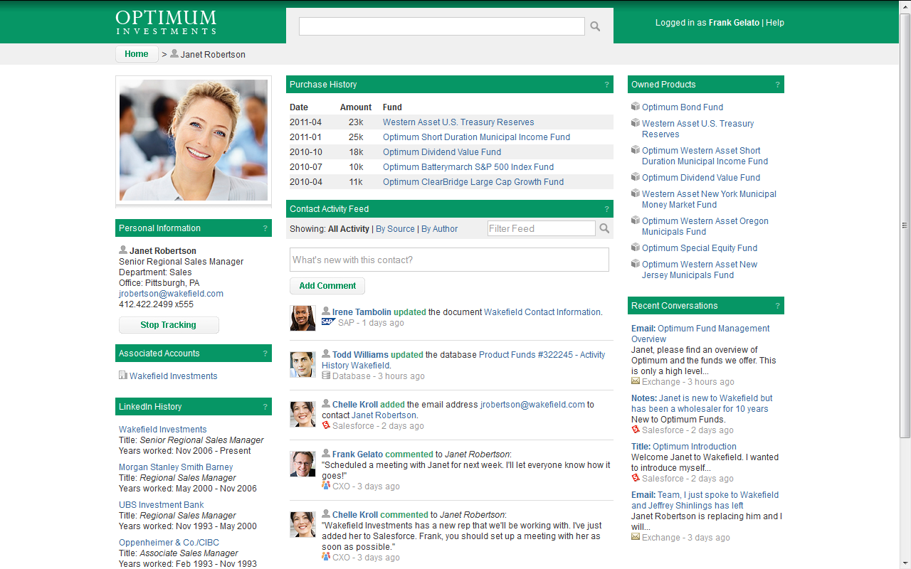


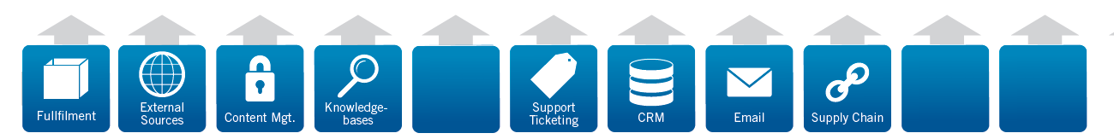



Enhanced 360º View of the Customer: Value & Diagram
SOURCE SYSTEMS
CRM
Name:
J Robertson
Address:
35 West 15th
Address:
Pittsburgh, PA 15213
ERP
Name:
Janet Robertson
Address:
35 West 15th St.
Address:
Pittsburgh, PA 15213
Legacy
Name:
Jan Robertson
Address:
36 West 15th St.
Address:
Pittsburgh, PA 15213
Master
Data
Management
360° View of Party Identity
First:
Janet
Last:
Robertson
Address:
35 West 15th St
City:
Pittsburgh
State/Zip:
PA / 15213
Unified View of Party’s Information
Gender:
F
Age:
48
BigInsights
Streams
Warehouse
DOB:
1/4/64
Unified View of Customer’s Information
Notes:
Jervin: All these extension to MDM, CRM etc.. Can be provided into a unified view of 360 degree view of customer’s information.. , provide a single search rather than multiple place for information..
Information about a client as viewed in an application built with the Data Explorer Application Builder.
The Data Explorer app combines information in context from CRM, content management, supply chain, order tracking database, e-mail and many more systems to give a 360º view of the client so the user doesn’t have to log into and search multiple different systems. In this one view the customer-facing professional can see all of the contact’s information -- what products she’s, any recent support incidents, news about her company, recent conversations and more. An “activity feed” in the center of the screen shows up-to-the-moment updates about the customer, product or other entity that is being viewed. Analytics from BigInsights, Streams and IBM’s BI products can also be shown, with the context of the analytics defined by the information displayed in the application. This frees the CFP to interact with the customer and leverage this complete view to increase revenue and improve customer loyalty.
As I mentioned a moment ago, this use case is very synergistic with IBM’s MDM offerings. MDM provides a single, consistent view of data across all of the client’s various systems. This consistency ensures that the view created by Data Explorer will incorporate consistent and accurate data about an entity. In one sense, Data Explorer provides a business user interface to trusted master data combined with related content from other structured and unstructured data sources. The availability of MDM accelerates implementation of the Data Explorer 360º application and ensures its accuracy and consistency.
8

Slide 9



Security/Intelligence Extension: Needs
Security/Intelligence Extension enhances traditional security solutions by analyzing all types and sources of under-leveraged data
Enhanced Intelligence & Surveillance Insight
Analyze data-in-motion & at rest to:
Find associations
Uncover patterns and facts
Maintain currency of information
Real-time Cyber Attack Prediction & Mitigation
Analyze network traffic to:
Discover new threats early
Detect known complex threats
Take action in real-time
Crime prediction & protection
Reduce Customer Churn
Analyze Telco & social data to:
Gather criminal evidence
Prevent criminal activities
Proactively apprehend criminals
Customer Retention
© 2013 IBM Corporation
Notes:
9

Slide 10

Asian Telco reduces billing costs and improves customer satisfaction.
Capabilities:
Stream Computing
Analytic Accelerators
Real-time mediation and analysis of 6 Billion CDRs per day
Data processing time reduced from 12 hrs to 1 sec
Hardware cost reduced to 1/8th
Proactively address issues (e.g. dropped calls) impacting customer satisfaction.
10
Notes:
10
We have been working with an Indian telco client for some time now to help reduce their billing costs and improve customer satisfaction.
Challenge:
Call Detail Record (CDR) processing within their data warehouse was sub-optimal,
Could not achieve real time billing which required handling billions of CDRs per day and de-duplication against 15 days worth of CDR data
Unable to support for future IT and Business with real-time analytics
Solution:
Single platform for mediation and real time analytics reduces IT complexity
The PMML standard is used to import data mining models from InfoSphere Warehouse. Offloaded the CDR processing to InfoSphere Streams resulting in enhanced data warehouse performance and improved TCO
Each incoming CDR is analyzed using these data mining models, allowing immediate detection of events (ex: dropped calls) that might create customer satisfaction issues.
Business Benefit:
Data now processed at the speed of Business - from 12 hours to 1 second
HW Costs reduced to 1/8th
Support for future growth without the need to re-architect, more data, more analysis
Platform in-place for real-time analytics to drive revenue

Slide 11
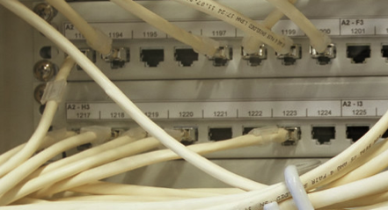
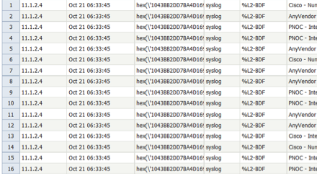
Operations Analysis: Needs
Analyze a variety of machine data for improved business results
Business Challenges:
Complexity and rapid growth of machine data
Difficult to capture small fraction of machine for better decision
In-ability to analyze machine data and combine it with enterprise data for a full view analysis
Benefits:
Gain real-time visibility into operations, customer experience, transactions and behavior
Proactively plan to increase operational efficiency
Identify and investigate anomalies
Monitor end-to-end infrastructure to proactively avoid service degradation or outages
Notes:
What is Operations Analysis?
It’s using big data technologies to enable a new generation of applications that analyze large volumes of multi-structured, often in-motion machine data and gain insight from it, which in turn improves business results
What are the drivers for an Operations Analysis use case?
In its raw format, businesses are unable to leverage machine data
Growing at exponential rates
Comes in large volumes, variety of formats, often in-motion
Needs to be combined with existing enterprise data
Requires complex analysis and correlation across different types of data sets
Requires unique visualization capabilities based on data type and industry/application
Organizations want to leverage machine data to improve business results and decision-making
11

Slide 12


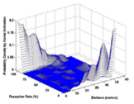











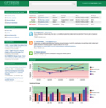

Operations Analysis: Value & Diagram
Indexing, Search
Only store
what is needed
Statistical Modeling
Raw Logs and Machine Data
Machine Data
Accelerator
Root Cause Analysis
Real-time Analysis
Federated Navigation & Discovery
Notes:
NET: Big ROI here for companies that adopt this – at the moment they may be making decisions based on up to 1-10% of their available information. ALSO – they are potentially storing information that they do not need…
Huge volumes of machine data (in lots of different formats) coming into your HDFS (BigInsights)
Data can also be coming from Streams
BigInsights, which comes with Machine Data Accelerator, is able to perform deep data analysis from all of these complex data sources.
Machine data can then be correlated with other enterprise data (customer, product information, etc.)
Combining IT and business data allows you to put it in the hands of operational-decision maker to increase operational intelligence.
These decision-makers can visualize data across many systems to get the most informed view
Business decisions are more informed and can happen in fraction of a second
They can:
Gain deep insights into operations & more
Proactively plan to increase efficiency
Visualize data from a variety of complex systems to aid in decision making
Real-time analysis to monitor and provide alerts
*Note that this is not a Tivoli play where we’re selling big data to IT so they can monitor their machines, hardware, applications or networks. This is about being able to leverage the data generated by machines to make better decisions and improve business results.
Products involved:
BigInsights, which comes with a new Machine Data Analytics Accelerator
Streams (optional), for analyzing data in-motion
InfoSphere Data Explorer, for federated navigation and discovery
Gain deep insights into operations, customer experience, transactions and behavior
Proactively plan to increase operational efficiency
Visualize data from a variety of complex systems to ensure all data is being used in decision-making
Machine Data Ingestion
Push data batches to HDFS
Validate metadata
Data parsing and extraction
Record splitting
Field extraction
Event standardization
Event generalization
Event enrichment
Data available for visualization via BigSheets
Customizable/extendable extraction rules
12

Slide 13






Data Warehouse Augmentation: Needs
Integrate big data and data warehouse capabilities to increase operational efficiency
Need to leverage variety of data
Extend warehouse infrastructure
Structured, unstructured, and streaming data sources required for deep analysis
Low latency requirements (hours—not weeks or months)
Required query access to data
Optimized storage, maintenance and licensing costs by migrating rarely used data to Hadoop
Reduced storage costs through smart processing of streaming data
Improved warehouse performance by determining what data to feed into it
Notes:
Jervin: Customer would like to leverage on VARIERY of Data (BigData) with the existing Data Warehouse ?..
What is data warehouse augmentation and what are the drivers?
Data Warehouse augmentation builds on an existing data warehouse infrastructure, leveraging big data technologies to ‘augment’ its value
Two main drivers:
Need to leverage variety of data
Structured, unstructured, and streaming
Low latency requirements (hours not weeks or months)
Requires query access to data
Optimize warehouse infrastructure
Warehouse data volumes reaching big data levels
Large portion of data in warehouse not accessed frequently
Need to optimize warehouse investment (Note: this is not to imply that our warehousing solutions are expensive, but instead that augmenting with big data technologies can make the warehouse a more optimal investment since you no longer attempt to store and analyze EVERYTHING within the warehouse, which can strain it from a performance and cost perspective.
13

Slide 14
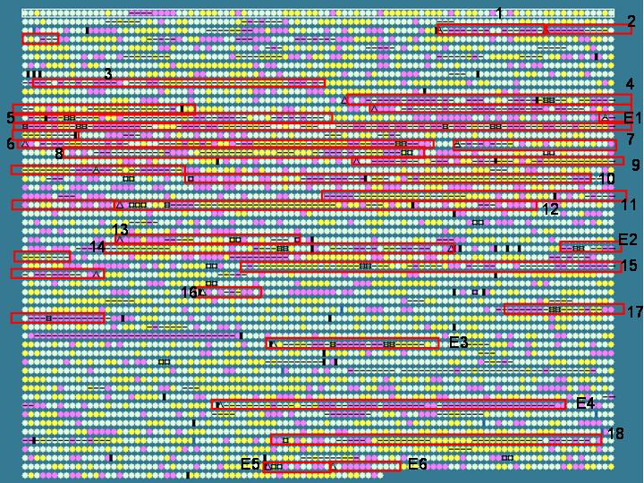

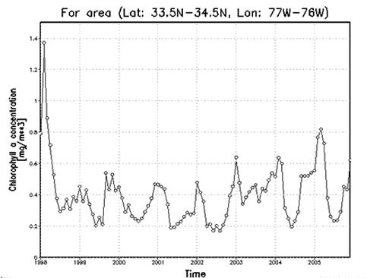

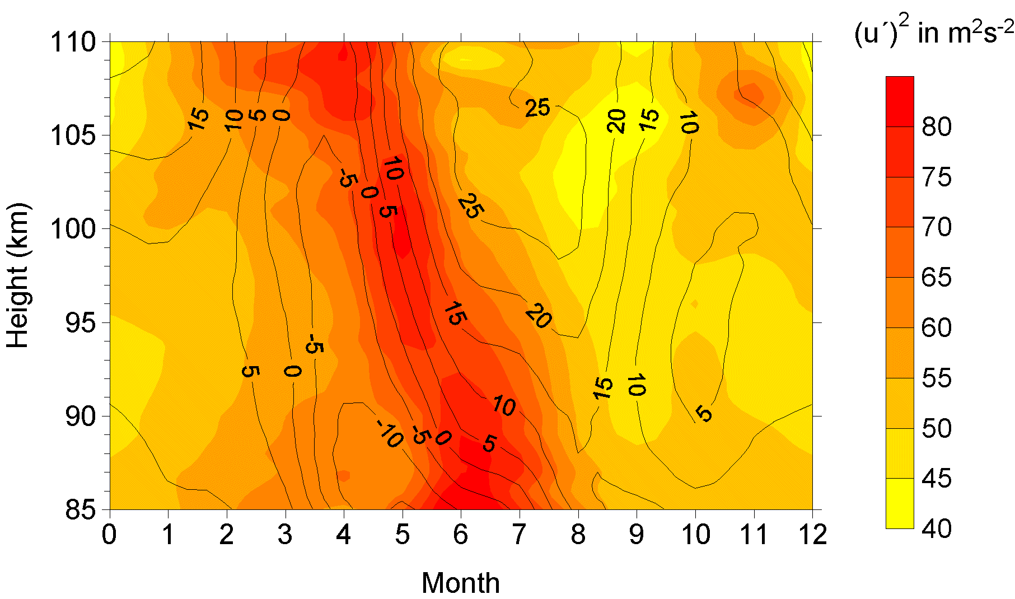

Variety of Data
Relational Data (Tables/Transaction/Legacy Data)
Text Data (Web)
Semi-structured Data (XML)
Graph Data
Social Network, Semantic Web (RDF), …
Streaming Data
You can only scan the data once
A single application can be generating/collecting many types of data
Big Public Data (online, weather, finance, etc)
To extract knowledge➔ all these types of data need to linked together

Slide 15
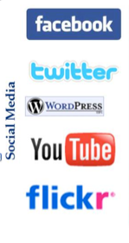


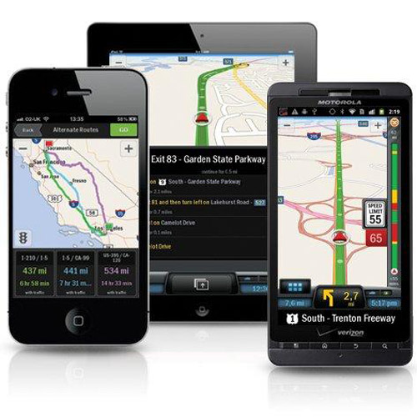

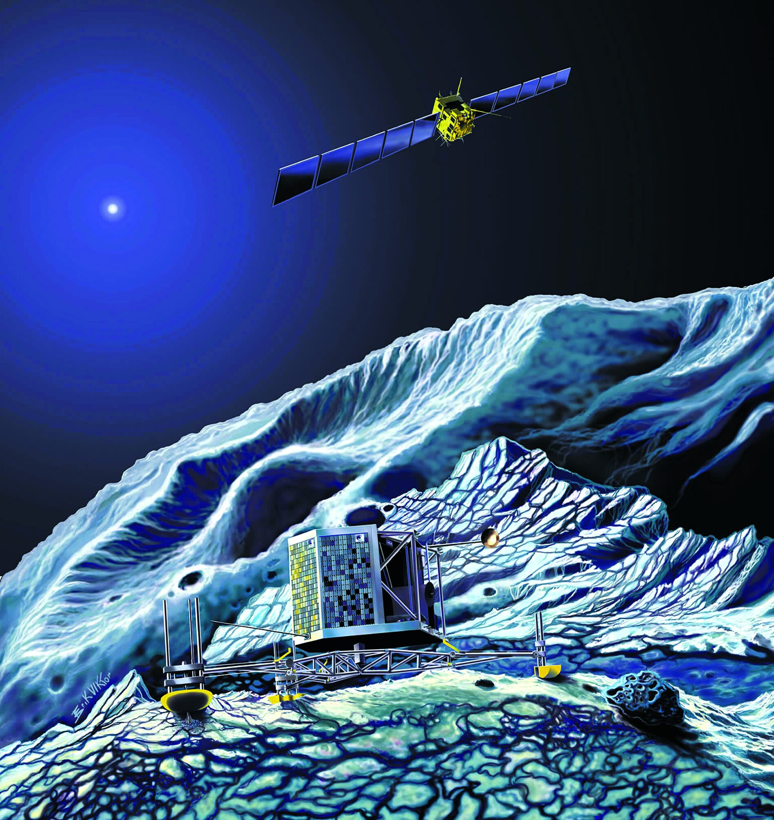
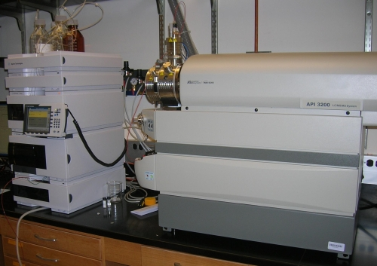
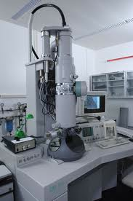
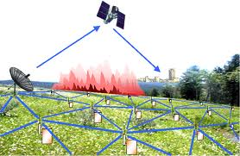
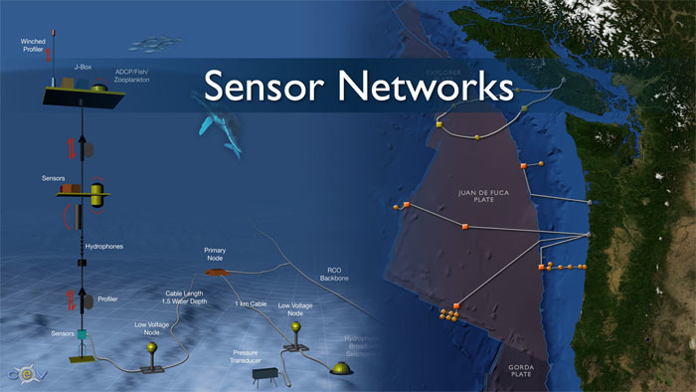
Real-time/Fast Data
Mobile devices
(tracking all objects all the time)
Social media and networks
(all of us are generating data)
Scientific instruments
(collecting all sorts of data)
Sensor technology and networks
(measuring all kinds of data)
The progress and innovation is no longer hindered by the ability to collect data
But, by the ability to manage, analyze, summarize, visualize, and discover knowledge from the collected data in a timely manner and in a scalable fashion

Slide 16
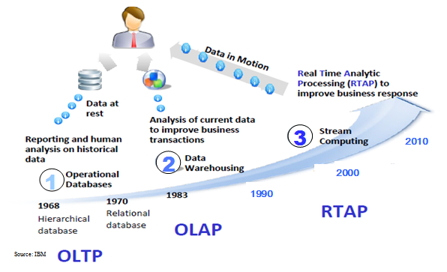
Harnessing Big Data
OLTP: Online Transaction Processing (DBMSs)
OLAP: Online Analytical Processing (Data Warehousing)
RTAP: Real-Time Analytics Processing (Big Data Architecture & technology)

Slide 17




The Model Has Changed…
The Model of Generating/Consuming Data has Changed
Old Model: Few companies are generating data, all others are consuming data
New Model: all of us are generating data, and all of us are consuming data

Slide 18
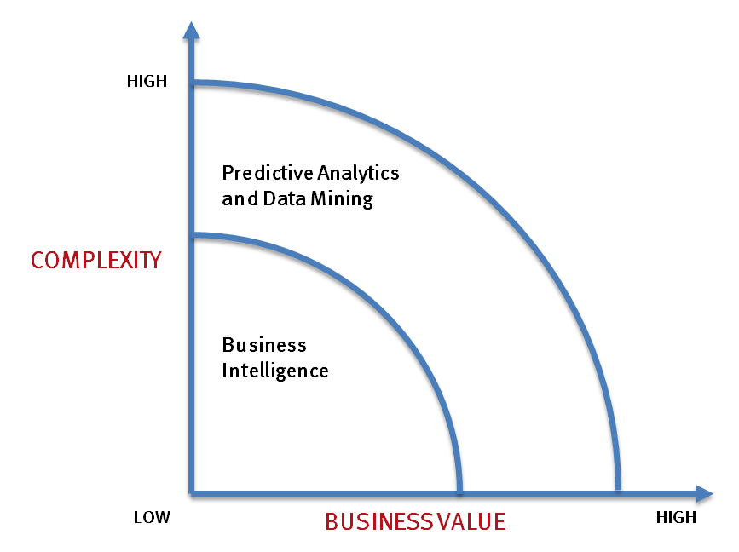
What’s driving Big Data
- Optimizations and predictive analytics
- Complex statistical analysis
- All types of data, and many sources
- Very large datasets
- More of a real-time
- Ad-hoc querying and reporting
- Data mining techniques
- Structured data, typical sources
- Small to mid-size datasets

Slide 19
The Evolution of Business Intelligence
Interactive Business Intelligence &
In-memory RDBMS
QliqView, Tableau, HANA
Big Data:
Real Time &
Single View
Graph Databases
Speed
Scale
BI Reporting
OLAP &
Dataware house
Business Objects, SAS, Informatica, Cognos other SQL Reporting Tools
Big Data:
Batch Processing &
Distributed Data Store
Hadoop/Spark; HBase/Cassandra
Scale
Speed
1990’s
2000’s
2010’s

Slide 20
Types of Big Data
Variety is the most unique aspect of Big Data. New technologies and new types of data have driven much of the evolution around Big Data.
Images, videos, audio, Flash, live streams, podcasts, etc.
Media
Social Media
Twitter, Linkedin, Facebook, Tumblr, Blog, SlideShare, YouTube, Google+, Instagram, Flickr, Pinterest, Vimeo, WordPress, IM, RSS, Review, Chatter, Jive, Yammer, etc.
XLS, PDF, CSV, email, Word, PPT, HTML, HTML 5, plain text, XML, JSON, etc.
Medical devices, smart electric meters, car sensors, road cameras, satellites, traffic recording devices, processors found within vehicles, video games, cable boxes, assembly lines, office building, cell towers, jet engines, air conditioning units, refrigerators, trucks, farm machinery, etc..
Docs
Sensor data
Government, weather, competitive, traffic, regulatory, compliance, health care services, economic, census, public finance, stock, OSINT, the World Bank, SEC/Edgar, Wikipedia, IMDb, etc.
Public Web
Machine Log
Data
Event logs, server data, application logs, business process logs, audit logs, call detail records (CDRs), mobile location, mobile app usage, clickstream data, etc.
Archives of scanned documents, statements, insurance forms, medical record and customer correspondence, paper archives, and print stream files that contain original systems of record between organizations and their customers
Archive
Business
Apps
Project management, marketing automation, productivity, CRM, ERP content management system, HR, storage, talent management, procurement, expense management Google Docs, intranets, portals, etc.

Slide 21
Types of data sets
Record
Data Matrix
Document Data
Transaction Data
Graph
World Wide Web
Molecular Structures
Ordered
Spatial Data
Temporal Data
Sequential Data
Genetic Sequence Data

Slide 22
Important Characteristics of Structured Data
Dimensionality
Curse of Dimensionality
Sparsity
Only presence counts
Resolution
Patterns depend on the scale

Slide 23
Record Data
Data that consists of a collection of records, each of which consists of a fixed set of attributes

Slide 24
Data Matrix
If data objects have the same fixed set of numeric attributes, then the data objects can be thought of as points in a multi-dimensional space, where each dimension represents a distinct attribute
Such data set can be represented by an m by n matrix, where there are m rows, one for each object, and n columns, one for each attribute

Slide 25
Document Data
Each document becomes a `term' vector,
each term is a component (attribute) of the vector,
the value of each component is the number of times the corresponding term occurs in the document.

Slide 26
Transaction Data
A special type of record data, where
each record (transaction) involves a set of items.
For example, consider a grocery store. The set of products purchased by a customer during one shopping trip constitute a transaction, while the individual products that were purchased are the items.

Slide 27
Graph Data
Examples: Generic graph and HTML Links

Slide 28
Chemical Data
Benzene Molecule: C₆H₆

Slide 29
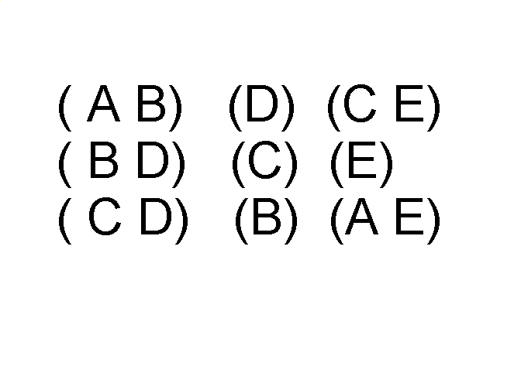
Ordered Data
Sequences of transactions
Items/Events
An element of the sequence

Slide 30
Ordered Data
Genomic sequence data

Slide 31
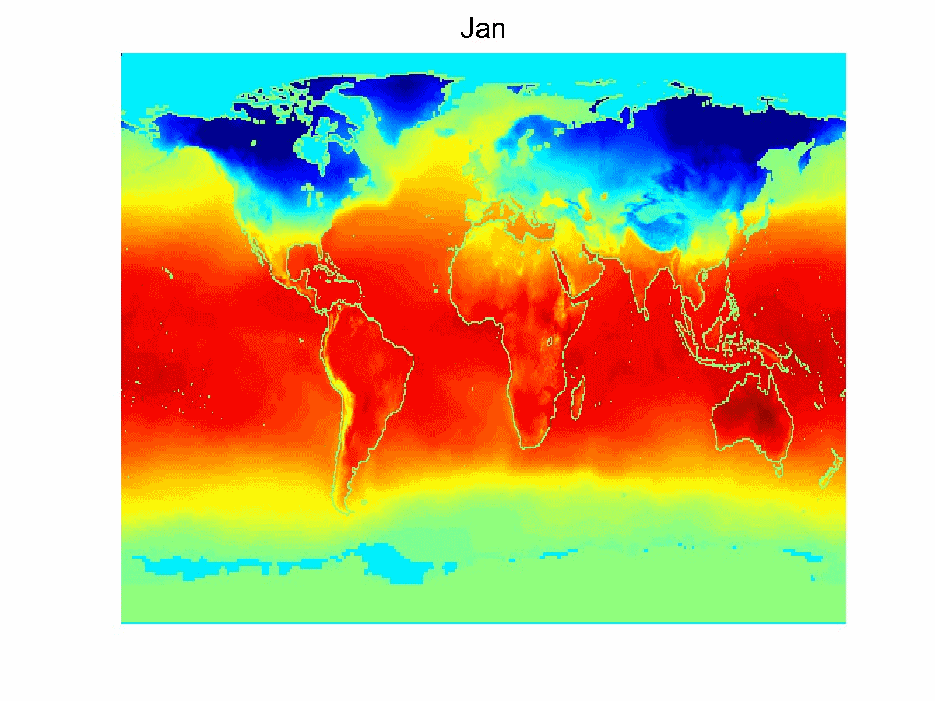
Ordered Data
Spatio-Temporal Data
Average Monthly Temperature of land and ocean

Slide 32
Data Quality
What kinds of data quality problems?
How can we detect problems with the data?
What can we do about these problems?
Examples of data quality problems:
Noise and outliers
missing values
duplicate data

Slide 33
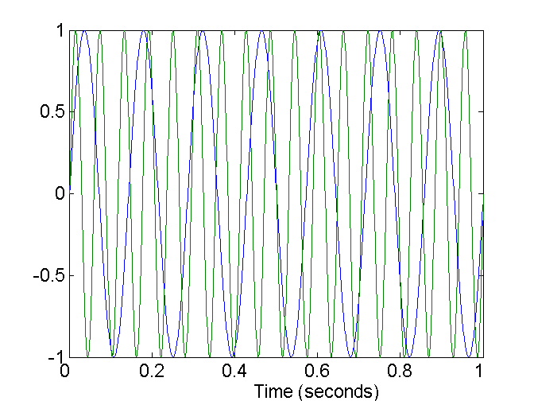
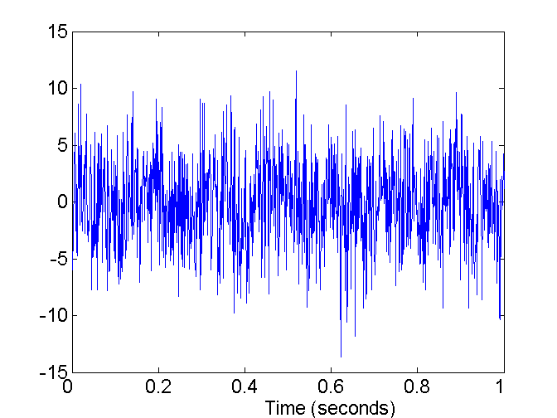
Noise
Noise refers to modification of original values
Examples: distortion of a person’s voice when talking on a poor phone and “snow” on television screen
Two Sine Waves
Two Sine Waves + Noise

Slide 34

Outliers
Outliers are data objects with characteristics that are considerably different than most of the other data objects in the data set

Slide 35
Missing Values
Reasons for missing values
Information is not collected (e.g., people decline to give their age and weight)
Attributes may not be applicable to all cases (e.g., annual income is not applicable to children)
Handling missing values
Eliminate Data Objects
Estimate Missing Values
Ignore the Missing Value During Analysis
Replace with all possible values (weighted by their probabilities)

Slide 36
Duplicate Data
Data set may include data objects that are duplicates, or almost duplicates of one another
Major issue when merging data from heterogeous sources
Examples:
Same person with multiple email addresses
Data cleaning
Process of dealing with duplicate data issues

Slide 37
Data Preprocessing
Aggregation
Sampling
Dimensionality Reduction
Feature subset selection
Feature creation
Discretization and Binarization
Attribute Transformation

Slide 38
Labwork: Web Scraping
https://github.com/gunturbudi/web-scraping/blob/master/Scraping%20Kompas.ipynb
https://github.com/prayanatrisna/python-notebook/blob/master/twitter-api-crawling/Crawling%20Twitter%20with%20API%20and%20Twython.ipynb

